Slide 1



Slide 2
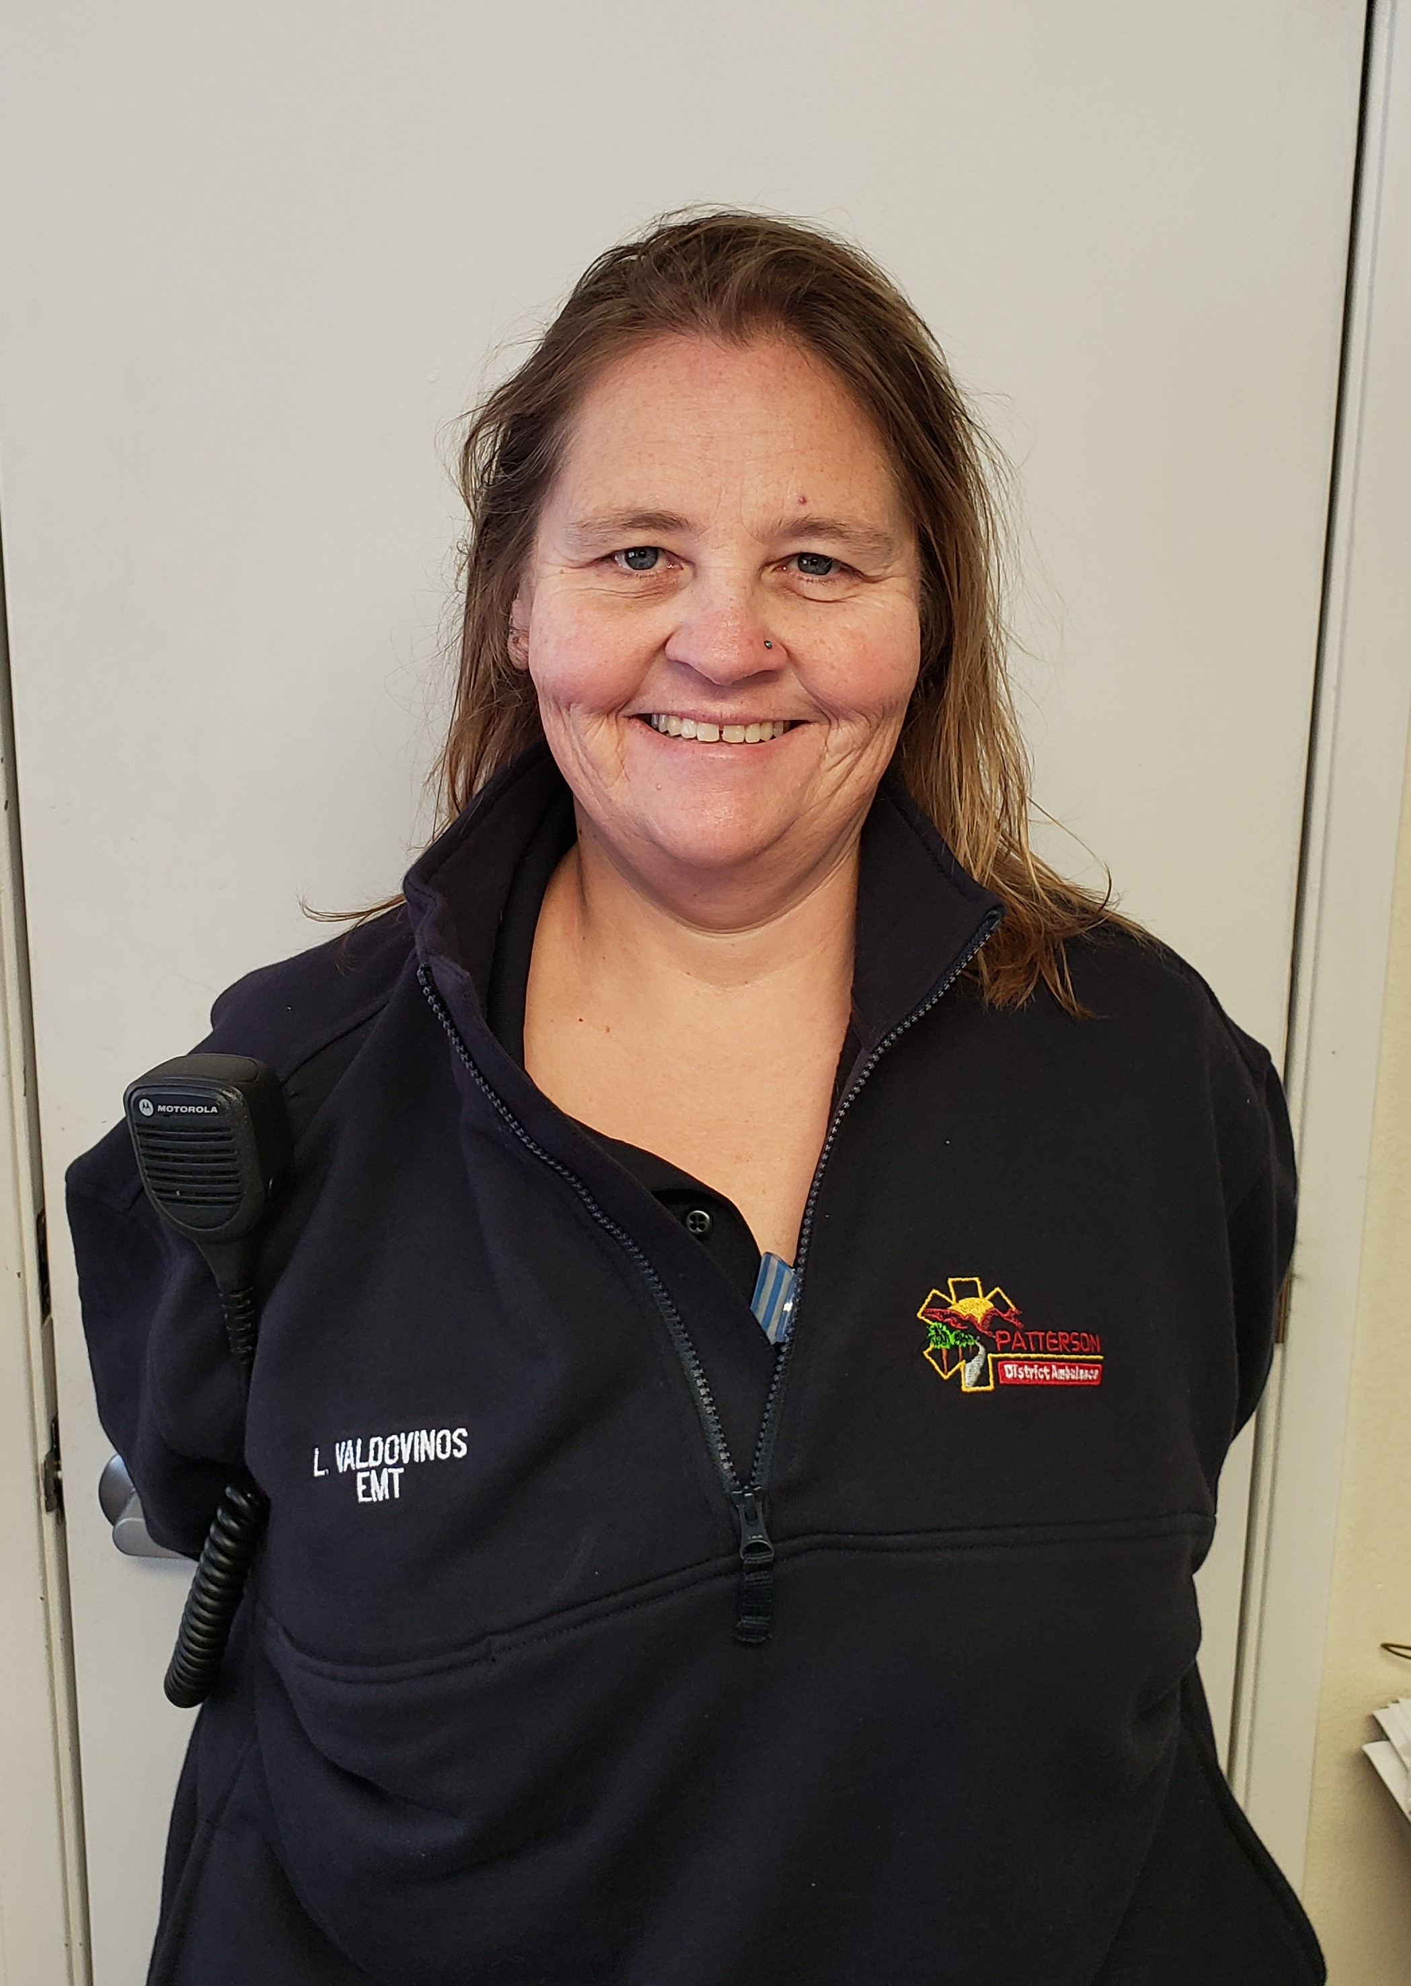
Lorie Valdovinos
EMT 12 Years

Slide 3
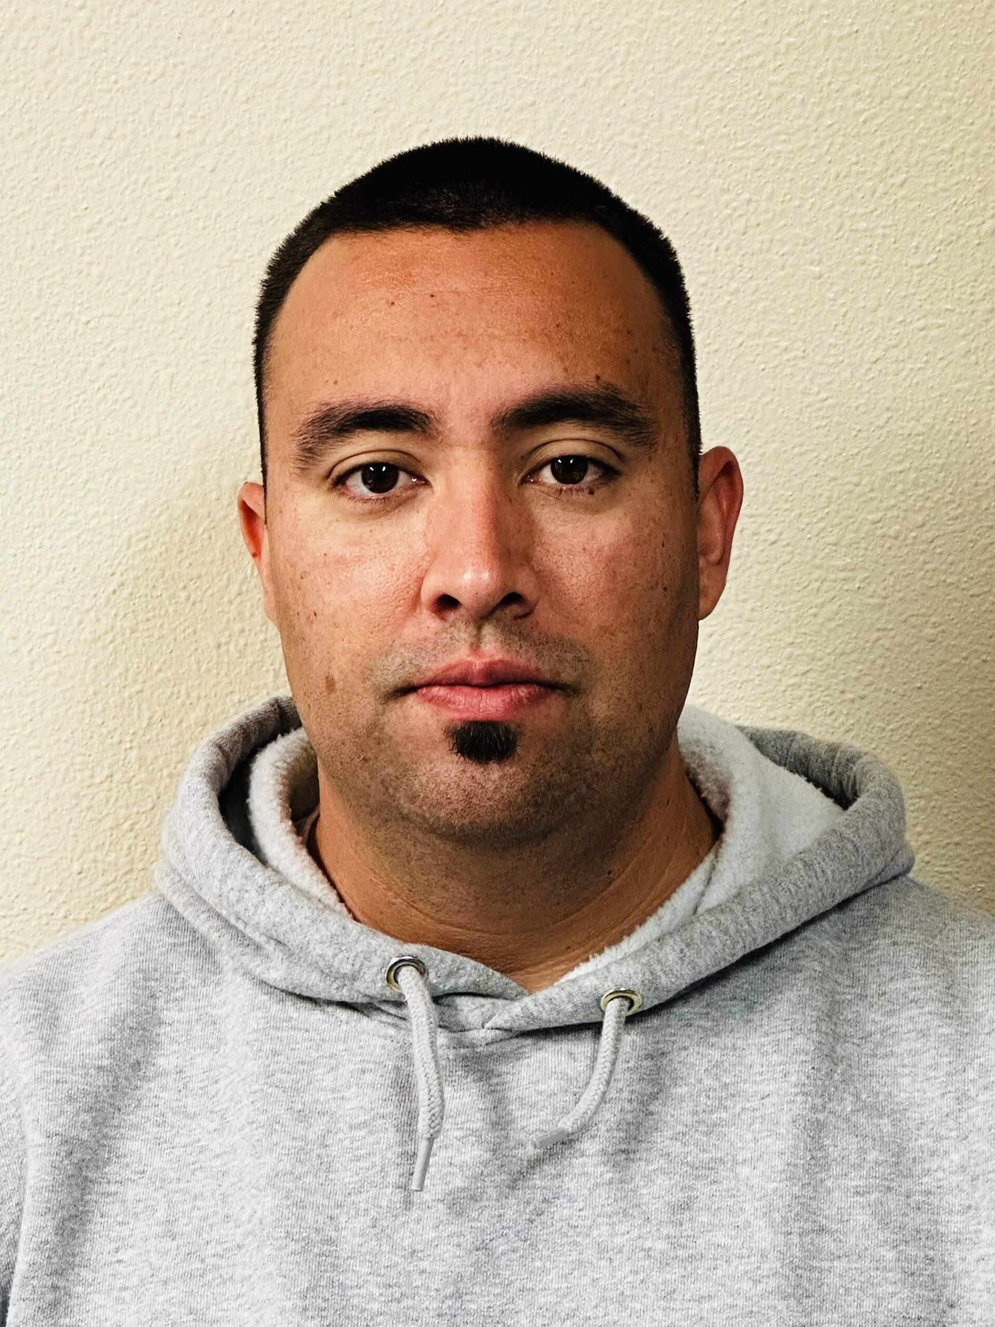
Anthony
Cordova
EMT- New Hire

Slide 4


Slide 5
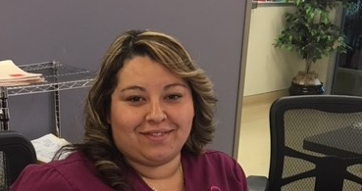
Susi Perez
M.A 8 Years

Slide 6

Yesenia Sanchez
M.A 3 Years

